Slide 1

Disease Recognition: Heart, Parkinson & Diabetes
BY SAHARSH BHATNAGAR (E23CSEU1737)
VIJAY MAVAI (E23CSEU1771)
PIYUSH CHAUHAN (E23CSEU1732)
ARSH KHAN (E23CSEU1773)

Slide 2
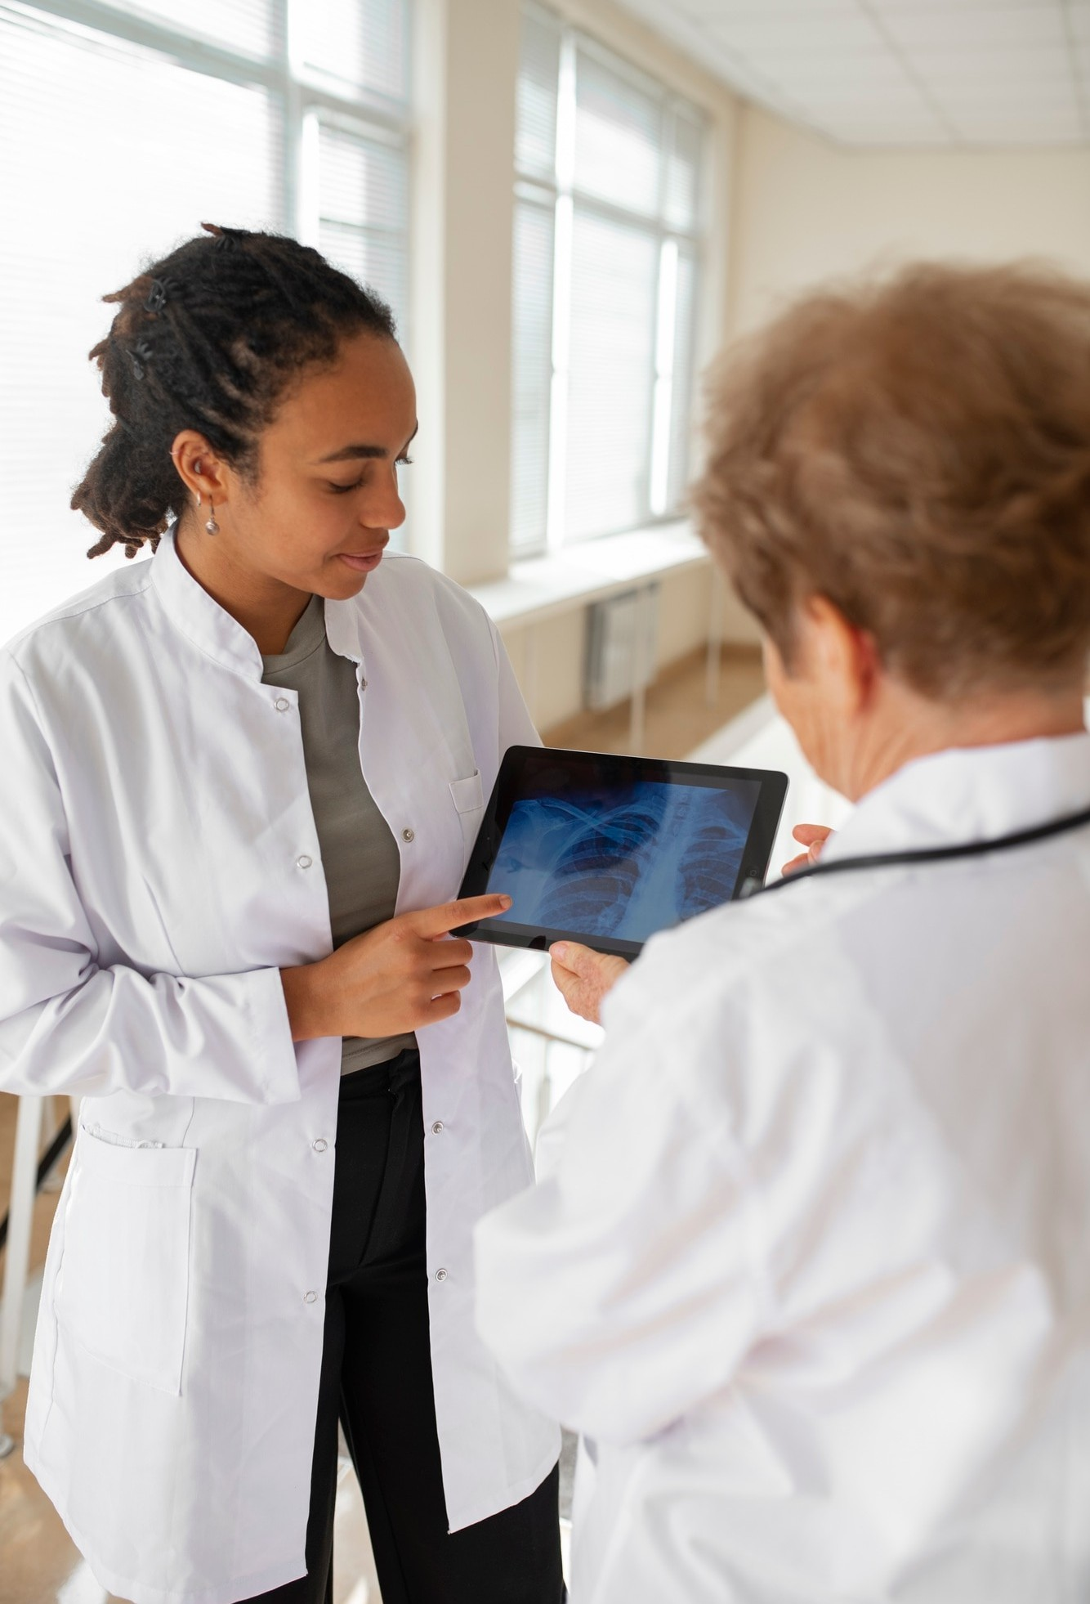


Heart Disease Detection
Machine learning models can analyze
to predict the risk of . By examining factors like age, cholesterol levels, and lifestyle
choices, these systems help doctors identify at- risk individuals earlier, allowing for timely interventions.

Slide 3



Parkinson's Disease Insights
Using
, researchers can analyze and speech to detect early signs
. This technology enhances
of
diagnosis accuracy and enables personalized treatment plans, improving quality of life for patients.

Slide 4




Diabetes Management
Machine learning algorithms can predict
based on various factors like diet, exercise, and medication.
This helps in creating tailored management plans for patients, leading to better health outcomes and
lifestyle adjustments.

Slide 5


Data Sources for ML
The eﬀectiveness of vast amounts of
in healthcare relies on
. Sources include electronic health
records, wearable devices, and patient surveys. The more data we have, the better the predictions and insights we can generate!

Slide 6


Benefits of Early Detection
Early detection of diseases through
can significantly reduce treatment costs and improve patient outcomes. By identifying risks before symptoms appear, healthcare providers can implement preventive measures, leading to healthier lives.

Slide 7


Future of Healthcare
The future of healthcare is bright with
. As technology continues to evolve, we can expect more precise diagnostics, tailored
treatments, and improved patient care. Embracing these innovations will lead to healthier communities.

Slide 8

Future Scope
The future of disease recognition for heart disease, Parkinson's, and diabetes lies in the integration of AI and machine learning for early detection, wearable technologies for continuous monitoring, and personalized medicine that tailors treatments based on individual genetic and health data. These advancements will enable more accurate diagnoses, proactive management, and improved patient outcomes.

Slide 9



Despite its potential, there are challenges in implementing
in healthcare, such as , algorithm biases, and the need for robust validation. Addressing these
issues is crucial for the successful integration of AI in medical practices.

Slide 10





In conclusion,
approach ,
is transforming the way we
, and . By
leveraging technology, we can enhance early detection, improve care, and ultimately save lives. Let's stay curious and supportive of these advancements!

Slide 11

Thank You
SAHARSH BHATNAGAR
E23CSEU1737
VIJAY MAVAI
E23CSEU1771
PIYUSH CHAUHAN E23CSEU1732
ARSH KHAN
E23CSEU1773)

